Slide 1

IS CANCER PREVENTABLE? Insights from the Health Information National Trends Survey on What Influences Perceptions of Cancer
Jongchan Kim and Rachel Orey

Slide 2
Division of work
50%
50%
Jongchan Kim
Topic Suggestion
Descriptive Statistics
Data Visualization
Hypothesis Testing
PPT
Rachel Orey
Feature Selection
Hypothesis Testing
Data Visualization
Report Writing
PPT

Slide 3

Dataset overview
Health Information National Trends Survey (HINTS)
Administered by the National Cancer Institute every few years since 2003.
We focused on the latest survey conducted: HINTS 5 Cycle 3.
Conducted January – June 2019
5,400 completed questionnaires
HINTS 5 Cycle 3 focuses on public perceptions of cancer and cancer prevention and public health behaviors.
The dataset includes:
More than 200 unique survey questions, many with multiple subparts.
5438 survey responses (rows) and 731 features (columns)

Slide 4

SMART Questions
We sought to understand more about who believes that cancer is not preventable and why.
Question 1: Are beliefs about cancer prevention influenced by demographic characteristics like age, education, and income?
Question 2: What other factors influence whether someone believes that cancer is preventable?

Slide 5

Descriptive statistics
Distribution of Responses to Target Survey Question:
How much do you agree or disagree: There’s not much you can do to lower your chances of getting cancer.
8%
Strongly Agree
38%
Somewhat Disagree
22%
Somewhat Agree
32%
Strongly Disagree

Slide 6
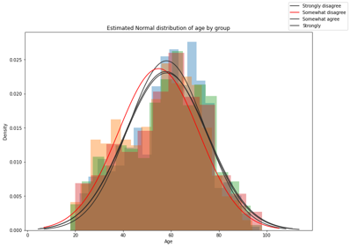
Descriptive statistics
Descriptive Statistics for Age Feature
Data Type | Total Entries | Minimum | Maximum | Mean | Variance | Standard Deviation
Ratio | 5110 | 18 | 98 | 56.9 | 282.5 | 16.8

Slide 7
Descriptive statistics
Distribution of Education among Survey Respondents
Education and Beliefs on Cancer Prevention
19%
Post Bachelor’s
6%
Less than High School
17%
High School Graduate
27%
Bachelor’s Degree
30%
Some College
(n=5145)

Slide 8
Descriptive statistics
Data Type | Total Entries | Most Common
Categorical | 4,675 | $100,000 to $200,000

Slide 9
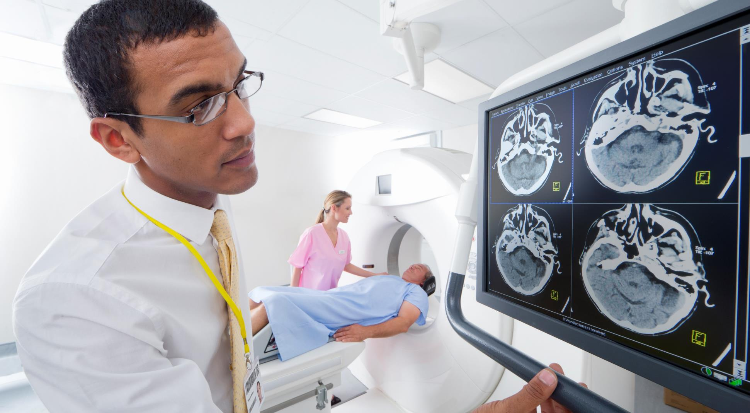
Hypothesis testing
Anova test for age AND BELIEFS ON CANCER PREVENTION
Null Hypothesis: There is no difference in age regarding cancer prevention beliefs.
Alternative Hypothesis: There is a difference in age regarding cancer prevention beliefs.
P-value | Degrees of Freedom Numerator | Degrees of Freedom Denominator | F-Statistic | F Critical Value (99% significance)
6.524e-10 | 3 | 5106 | 15.31 | 3.801
ANOVA test conducted with original code in Python.
P-value (calculated with scipy stats) tells us with high confidence that we can REJECT the null hypothesis.
F-Statistic > F Critical Value means that we can REJECT the null hypothesis
Conclusion: There is a difference in age regarding cancer prevention beliefs.

Slide 10
Hypothesis testing
Chi-square test for education AND BELIEFS ON CANCER PREVENTION
Null Hypothesis: There is no correlation between education and prevention beliefs.
Alternative Hypothesis: There is correlation between education and prevention beliefs.
P-value | Degrees of Freedom | Chi Square Statistic | Chi Critical Value (99% significance)
1.0042e-66 | 12 | 345.95 | 26.217
Chi-square test conducted in Python with scipy.stats.chi2_contingency
P-value tells us with high confidence that we can REJECT the null hypothesis.
Chi-Statistic > Chi Critical Value means that we can REJECT the null hypothesis
Conclusion: There is correlation between education and cancer prevention beliefs.

Slide 11
Hypothesis testing
Chi-square test for income AND BELIEFS ON CANCER PREVENTION
Null Hypothesis: There is no correlation between income and prevention beliefs.
Alternative Hypothesis: There is correlation between income and prevention beliefs.
P-value | Degrees of Freedom | Chi Square Statistic | Chi Critical Value (99% significance)
1.51e-31 | 24 | 209.471 | 42.98
Chi-square test conducted in Python with scipy.stats.chi2_contingency
P-value tells us with high confidence that we can REJECT the null hypothesis.
Chi-Statistic > Chi Critical Value means that we can REJECT the null hypothesis
Conclusion: There is correlation between education and cancer prevention beliefs.

Slide 12
SMART Questions
We sought to understand more about who believes that cancer is not preventable and why.
Question 1: Are beliefs about cancer prevention influenced by demographic characteristics like age, education, and income?
Question 2: What other factors influence whether someone believes that cancer is preventable?

Slide 13
FEATURE SELECTION
The HINTS dataset had more than 370 features. How do we know which to analyze?
Feature selection techniques:
Filtering Highly Correlated Variables
Chi Square Tests

Slide 14
Correlation Matrix of Section N: Cancer Beliefs
For illustrative purposes only. Method applied to entire dataset.
 | chancegetcancernodx | freqworrycancernodx | familyeverhadcancer | everythingcausecancer | toomanyrecommendations | cancersign_unexpbleeding | cancersign_bowelbladderchange | cancersign_unexpweightloss | influencecancer_obesity | influencecancer_eatingfiber | influencecancer_processedmeat | influencecancer_eatingfruitveg
chancegetcancernodx | 1.00 | 0.28 | -0.16 | 0.04 | 0.06 | -0.10 | -0.09 | -0.08 | 0.08 | 0.05 | 0.09 | 0.04
freqworrycancernodx | 0.28 | 1.00 | 0.00 | -0.06 | -0.05 | 0.01 | -0.01 | 0.01 | -0.03 | -0.02 | -0.02 | -0.03
familyeverhadcancer | -0.16 | 0.00 | 1.00 | -0.02 | 0.00 | 0.10 | 0.11 | 0.11 | -0.06 | -0.05 | -0.04 | -0.05
everythingcausecancer | 0.04 | -0.06 | -0.02 | 1.00 | 0.25 | -0.06 | -0.06 | -0.05 | 0.07 | 0.06 | 0.07 | 0.03
toomanyrecommendations | 0.06 | -0.05 | 0.00 | 0.25 | 1.00 | -0.04 | -0.04 | -0.04 | 0.04 | 0.03 | 0.05 | -0.01
cancersign_unexpbleeding | -0.10 | 0.01 | 0.10 | -0.06 | -0.04 | 1.00 | 0.72 | 0.67 | -0.21 | -0.12 | -0.22 | -0.05
cancersign_bowelbladderchange | -0.09 | -0.01 | 0.11 | -0.06 | -0.04 | 0.72 | 1.00 | 0.71 | -0.20 | -0.14 | -0.21 | -0.06
cancersign_unexpweightloss | -0.08 | 0.01 | 0.11 | -0.05 | -0.04 | 0.67 | 0.71 | 1.00 | -0.20 | -0.12 | -0.21 | -0.06
influencecancer_obesity | 0.08 | -0.03 | -0.06 | 0.07 | 0.04 | -0.21 | -0.20 | -0.20 | 1.00 | 0.31 | 0.36 | 0.17
influencecancer_eatingfiber | 0.05 | -0.02 | -0.05 | 0.06 | 0.03 | -0.12 | -0.14 | -0.12 | 0.31 | 1.00 | 0.27 | 0.47
influencecancer_processedmeat | 0.09 | -0.02 | -0.04 | 0.07 | 0.05 | -0.22 | -0.21 | -0.21 | 0.36 | 0.27 | 1.00 | 0.11
influencecancer_eatingfruitveg | 0.04 | -0.03 | -0.05 | 0.03 | -0.01 | -0.05 | -0.06 | -0.06 | 0.17 | 0.47 | 0.11 | 1.00

Slide 15

FEATURE SELECTION
Filtering by Correlation
Siphoning features with correlation above 70% reduced the number of features from 371 to 219
Chi Square
371 still too many to analyze
Applied stats.chi2_contingency to calculate p-value for remaining features and the target variable (preventnotpossible). Features with p < .01 were removed.
This reduced the number of features from 371 to 152
Sorted features by p-value to determine which are most related to beliefs on prevention, top 4 features were:
Feature | P-Value
toomanyrecommendations | 8.600770e-275
everythingcausecancer | 9.512882e-213
education | 3.033847e-70
influencecancer_eatingfruitveg | 4.119672e-63

Slide 16
limitations
Almost all of the data was categorical, limiting the types of analysis we could conduct.
Some data, like income, would have been better in the form of numeric data.
Age distribution of survey respondents (median ~54) doesn’t accurately reflect age distribution of the United States (median ~ 40).
Additionally, no children (under 18) are included in the survey.
Having a wider spread of age would help understand when perceptions about cancer are cemented and whether health-organizations need to focus on youth education.
Survey also over-represents those with high incomes.

Slide 17
conclusion
Takeaways
Age, education, and income each have a statistically significant relationship with beliefs on cancer prevention:
Those with lower levels of education and low incomes are more likely to believe that cancer is not preventable than their counterparts.
Additional research should be conducted to further explore the relationship between age and cancer prevention beliefs.
Of all the survey questions asked, those who said that there were too many cancer recommendations to know what’s true were most likely to believe that cancer is not preventable.
Health- and cancer-related organizations should focus on distributing less frequent, but more targeted, health information to less educated and less wealthy individuals. This would help to combat information overload and focus resources where they are needed most.

